Slide 1
Update on
Sabbatical and Leaves with Pay and
Tenure Density
February 6, 2024
Carleen Mandolfo
Associate Provost for Faculty Affairs

Slide 2
Sabbatical and
Leaves with Pay

Slide 3
Sabbatical and Leave with Pay Policies
CBA, Senate Policy, Administration
CBA Articles 27-28: https://www.calstate.edu/csu-system/faculty-staff/labor-and-employee-relations/Pages/unit3-cfa.aspx
Academic Senate Policy: https://senate.sfsu.edu/sites/default/files/documents/S22-301_Sabbatical_and_Leaves_with_Pay_Policy.pdf
Policy Administration/Implementation: https://facaffairs.sfsu.edu/leaves-withwithout-pay

Slide 4
Workshops
  Since Fall 2022, the Academic Senate Faculty Affairs Committee and the Office of Faculty Affairs and Professional Development have presented workshops for faculty preparing applications for a Leave With Pay.
  The sessions were recorded and made available for all those who were unable to attend.
  Beginning last Fall (2022) AP Mandolfo meets with USC to ensure compliance with the revised Senate policy, and to minimize unintentional bias in the process.

Slide 5
Sabbatical and DIP Eligibility
To be eligible for a sabbatical leave, the applicant must have served full-time for six (6) years at this campus in the preceding seven (7) year period prior to the leave and at least six (6) years after any previous sabbatical leave or difference in pay leave. This includes lecturer faculty as well as tenure/tenure track faculty.

Slide 6
Leaves With Pay Awards for AY 2023-2024
Eligibility, Application and Awards
  ELIGIBILTY
  Faculty eligible to apply
  278 tenure track/tenured faculty
    49 lecturer faculty
  12% to award = 40
  APPLICATIONS RECEIVED
  Sabbatical, 1 semester
    70 tenure track/tenured faculty
    5 lecturer faculty
  Sabbatical, AY
    16 tenure track/tenured faculty
    1 lecturer faculty
  Difference in Pay
    14 tenure track/tenured faculty
  AWARDED
  Sabbatical, 1 semester
    40 tenure track/tenured faculty
    2 lecturer faculty
  Sabbatical, AY
  16 tenure track/tenured faculty
    1 lecturer faculty
  Difference in Pay (DIP)
    14 tenure track/tenured faculty

Slide 7
SABBATICAL - Semester
2022-2023 Application Year for Awards in AY 2023-2024

Slide 8
SABBATICAL - AY
2022-2023 Application Year for Awards in AY 2023-2024

Slide 9
DIFFERENCE IN PAY LEAVE (DIP)
2022-2023 Application Year for Awards in AY 2023-2024

Slide 10
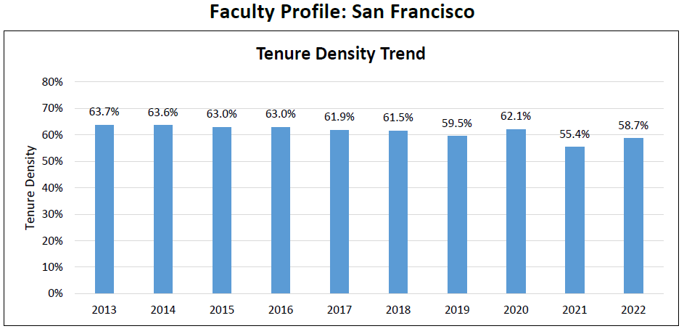
Tenure Density
Data Source: CSU Systemwide Human Resources, CIRS AN Files

Slide 11
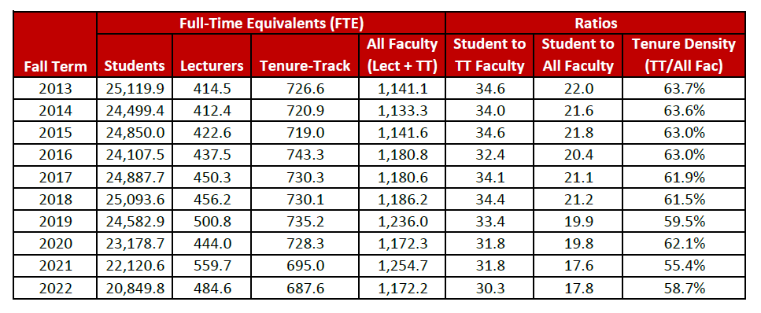
Tenure Density
Data Source: CSU Systemwide Human Resources, CIRS AN Files

Slide 12
T/TT Faculty by College and Gender
Fall 2023
Excludes FERP and Administrators
Note: Non-binary added to gender classification effective AY 2022-2023.

Slide 13
T/TT Faculty by College and Ethnic Background (Headcount)
Fall 2023
Excludes FERP faculty and Administrators
 | BUS |  | EDUC |  | ETHS |  | HSS |  | LCA |  | SCI |  | LIB |  | TOTALS
 | Count | % | Count | % | Count | % | Count | % | Count | % | Count | % | Count | % | Count | %
American Indian/Alaska Native | 1 | 1% | 0 | 0% | 2 | 5% | 2 | 2% | 3 | 1% | 3 | 2% | 0 | 0% | 11 | 2%
Asian* | 53 | 56% | 10 | 28% | 14 | 37% | 28 | 29% | 35 | 15% | 56 | 35% | 2 | 22% | 198 | 30%
Black/African American | 2 | 2% | 1 | 3% | 9 | 24% | 4 | 4% | 10 | 4% | 4 | 2% | 0 | 0% | 30 | 5%
Hispanic/Latinx | 1 | 1% | 4 | 11% | 6 | 16% | 7 | 7% | 15 | 7% | 13 | 8% | 0 | 0% | 46 | 7%
Native Hawaiian/Oth Pac Island | 0 | 0% | 0 | 0% | 2 | 5% | 0 | 0% | 0 | 0% | 0 | 0% | 0 | 0% | 2 | 0%
White | 34 | 36% | 17 | 47% | 3 | 8% | 50 | 53% | 153 | 67% | 77 | 48% | 6 | 67% | 340 | 51%
Not Specified | 3 | 3% | 4 | 11% | 2 | 5% | 4 | 4% | 13 | 6% | 9 | 6% | 1 | 11% | 36 | 5%
TOTAL T/TT | 94 | 100% | 36 | 100% | 38 | 100% | 95 | 100% | 229 | 100% | 162 | 100% | 9 | 100% | 663 | 100%
*Includes: Asian Indian, Chinese, Filipino, Japanese, Korean, Other Asian

Slide 14
Summary of Associate Professors/Librarians
Eligible for Promotion to Full Review in Fall 2022 and
Actual Promotions Effective Fall 2023

Slide 15
Contact us https://facaffairs.sfsu.edu/

